Slide 1
Building Models with Keras
UNIT-II

Slide 2

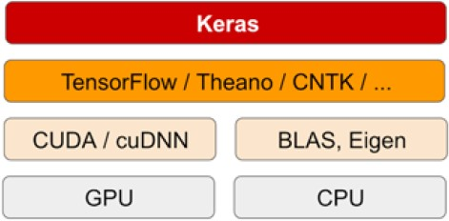
Keras
A python package (Python 2.7-3.6)
Sits on top of TensorFlow or Theano (Stopped)
High-level neural network API
Runs seamlessly on CPU and GPU
Open source with user manual (https://keras.io/)
Less coding lines required to build/run a model

Slide 3
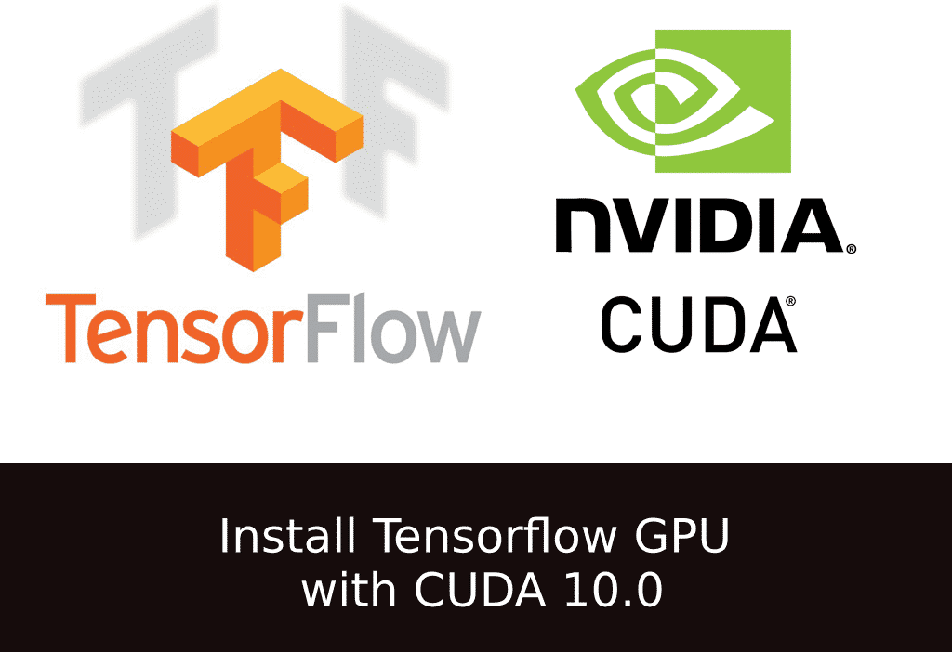
TensorFlow
Inherit from Theano (data flow graph)
A python(3.5-3.7) package/C++ library
Running on CPU or NVIDIA CUDA GPU
End-2-End platform for machine/deep learning
Multi platform (desktop, web by TF.js, mobile by TF Lite)
Open source with user manual (https://www.tensorflow.org/)
More coding lines required to build/run a model

Slide 4

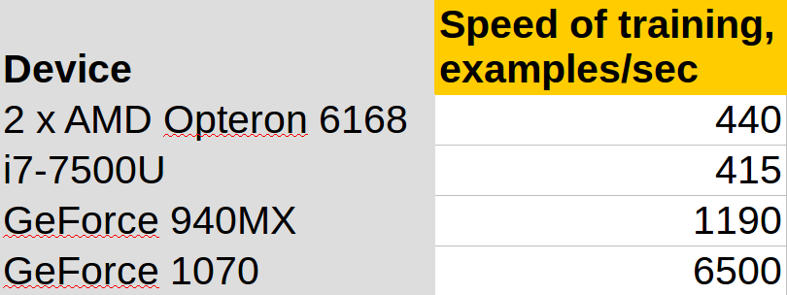
NVIDIA CUDA Toolkit
C/C++ library
A parallel computing platform for NVIDIA GPU
Most deep learning researchers rely on
GPU-accelerated computing/applications
Not open source (https://developer.nvidia.com/cuda-zone)
CPU vs GPU: TensorFlow training CNN model on CIFAR10 images

Slide 5

Anaconda3 Installation
Anaconda3
Download (https://www.anaconda.com/distribution/)
Installation (https://docs.anaconda.com/anaconda/install/)
Restart required

Slide 6
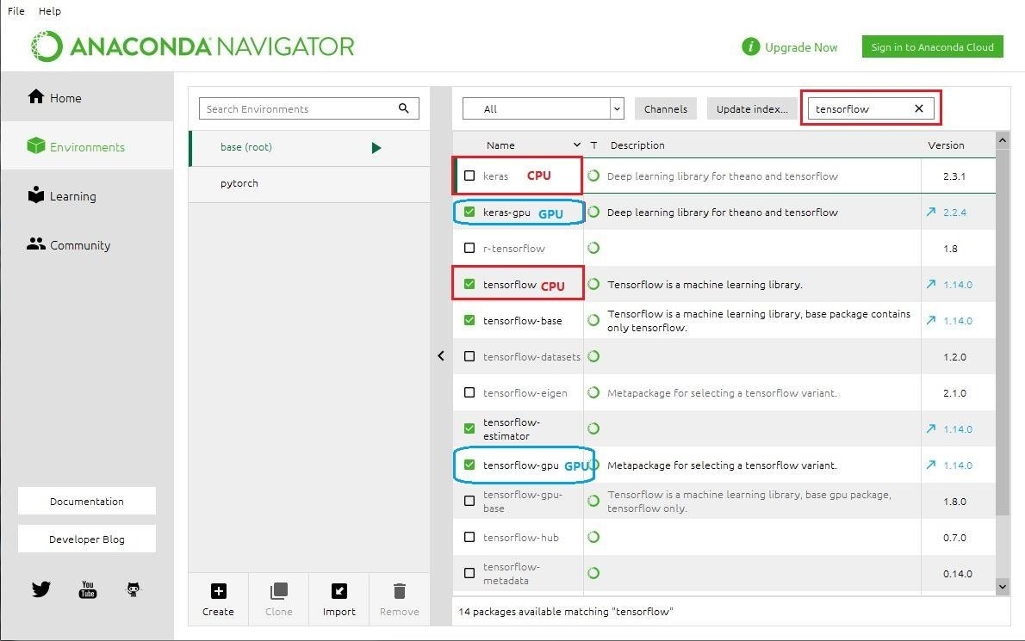
TensorFlow/Keras Installation
Start the anaconda navigator
Windows: Start->All program->Anaconda3-
>Anaconda Navigator
Linux: type “anaconda-navigator” under the
linux terminal
Install TensorFlow and Keras
Environments->choose All
type “tensorflow”
CPU based:
tensorflow (choose 1.14)
keras (2.2.4) apply
GPU based:
CUDA Compute Capability >= 3.0, better
>= 3.7 (check more)
tensorflow-gpu (choose 1.14) and keras- gpu (2.2.4), then apply

Slide 7

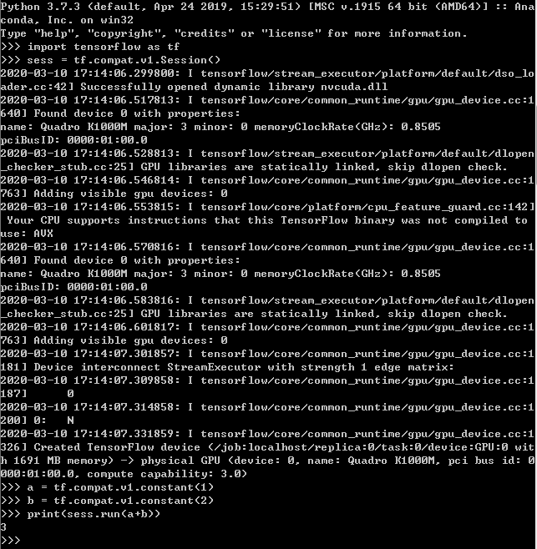

Installation Confirmed
TensorFlow test code:
import tensorflow as tf
sess = tf.compat.v1.Session() a = tf.compat.v1.constant(1) b = tf.compat.v1.constant(2) print(sess.run(a+b))
Expect to have answer 3

Slide 8
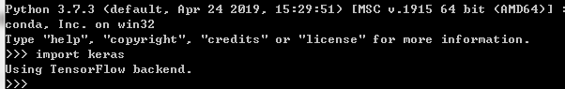
Installation Confirmed
Keras requires backend setting for Windows users:
https://keras.io/backend/
Setting in keras.json: “backend”: “tensorflow”
Keras test code:
import keras
Expect to see
Using TensorFlow backend

Slide 9
Keras Models
Two main types of models available
The Sequential model (easy to learn, high-level API)
A linear stack of layers
Need to specify what input shape it should expect (input dimension)
https://keras.io/getting-started/sequential-model-guide/
The Model class used with the functional API (similar to tensorflow2.0)
https://keras.io/models/about-keras-models/
https://keras.io/getting-started/functional-api-guide/

Slide 10
Keras Sequential Model
Define a sequential model
model = Sequential() mode.add(Dense(32, input_dim=784)) model.add(Activation(‘relu’)) model.add(Dense(10))
model.add(Activation(‘softmax’))
Compilation
model.compile(optimizer=‘rmsprop’,
loss=‘binary_crossentropy’, metrics=[‘accuray’])
Training
model = model.fit(data, one_hot_labels, epoch=10, batch_size=32)
Predition
Y = model.predict(X)

Slide 11
Keras: Layers
Input:
input_img = Input(shape=(rows , cols , channels))
Dense:
x = Dense(num_of_units , activation=‘activation_function’)
Conv2D:
x = Conv2D(num_of_filters, kernel_size , stride,
activation=‘activation_function’,padding=‘type_of_padding’)
MaxPool2D:
x = MaxPool2D(kernel_size)
Flatten:
Dropout:
x = Dropout(value_of_dropout)

Slide 12
Keras: Optimizers
SGD
RMSProp
AdaGrad
Adam
…

Slide 13
Keras: Activation Functions
Sigmoid
Tanh
Relu
LeakyRelu
ELU
Softmax
…

Slide 14
Keras: Cost Functions
Mean Squared Error (‘mse’)
Binary Cross Entropy (‘binary_crossentropy’)
Kullback Leibler Divergence (‘kullback_leibler_divergence’)
…

Slide 15
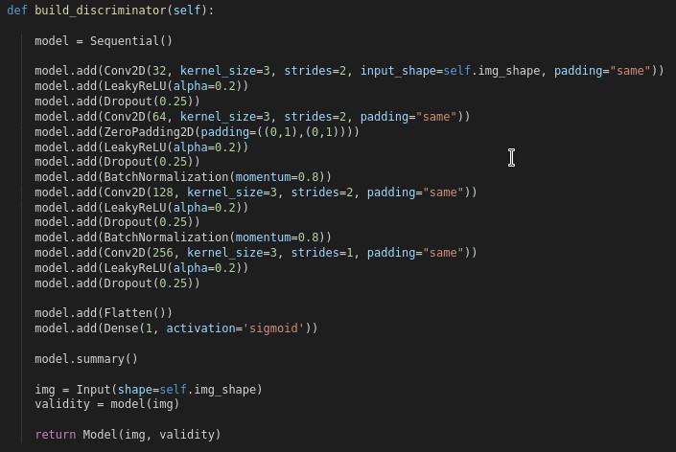
Keras: Defining the architecture
There are two ways to define the architecture:

Slide 16
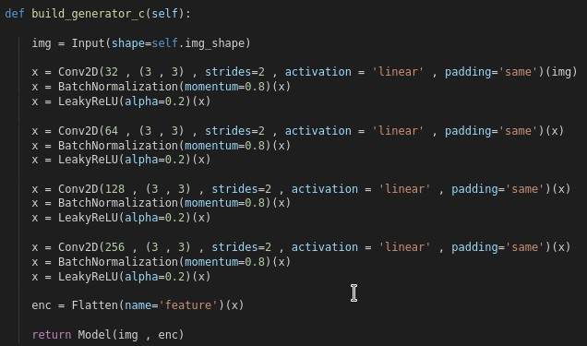
Keras: Defining the architecture
There are two ways to define the architecture:

Slide 17
Exercises:
Exercise 1:
Define the network architecture following the LeNet-5 model.
Exercise 2:
Evaluate the network performance in terms of accuracy in relation to the change of:
Learning rate: 0.1 and 0.001.
Activation functions: ReLU and Sigmoid.
Dropout values: 0.25, 0.5 and 0.75

Slide 18
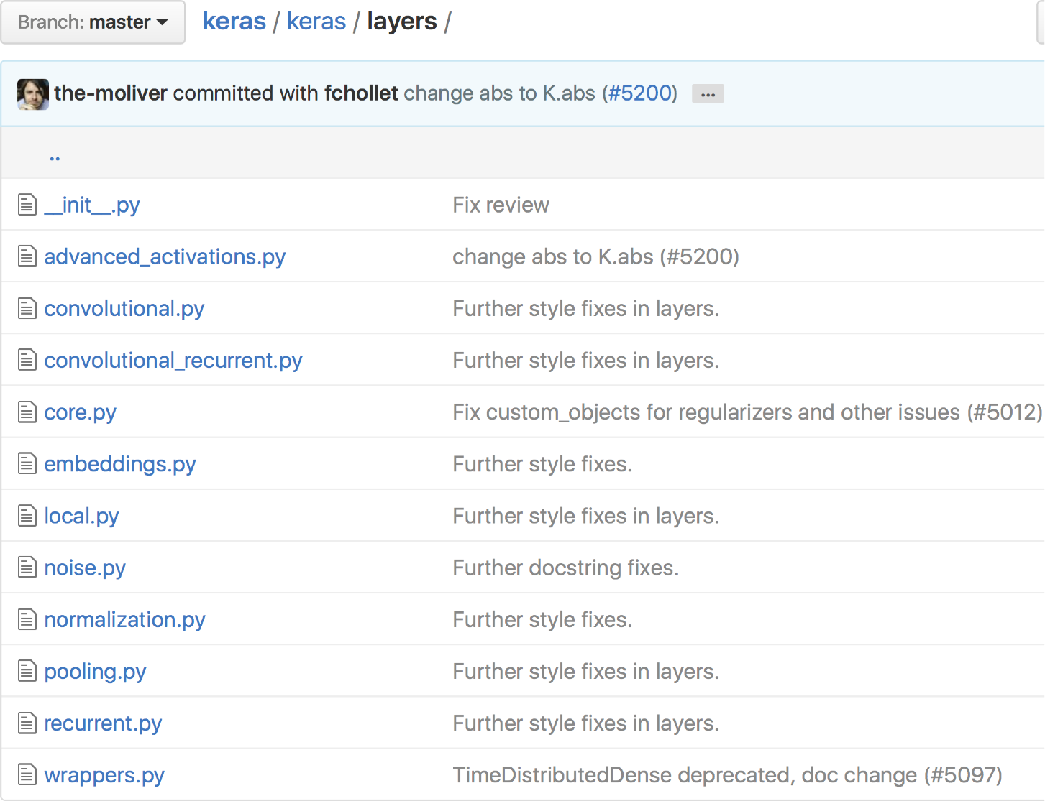
Layers

Slide 19
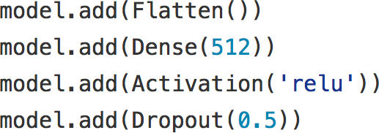

Slide 20
linear
•
•
sigmoid
•
tanh
•
relu

Slide 21
PReLU
•
•
Leaky ReLU
•
SReLU

Slide 22
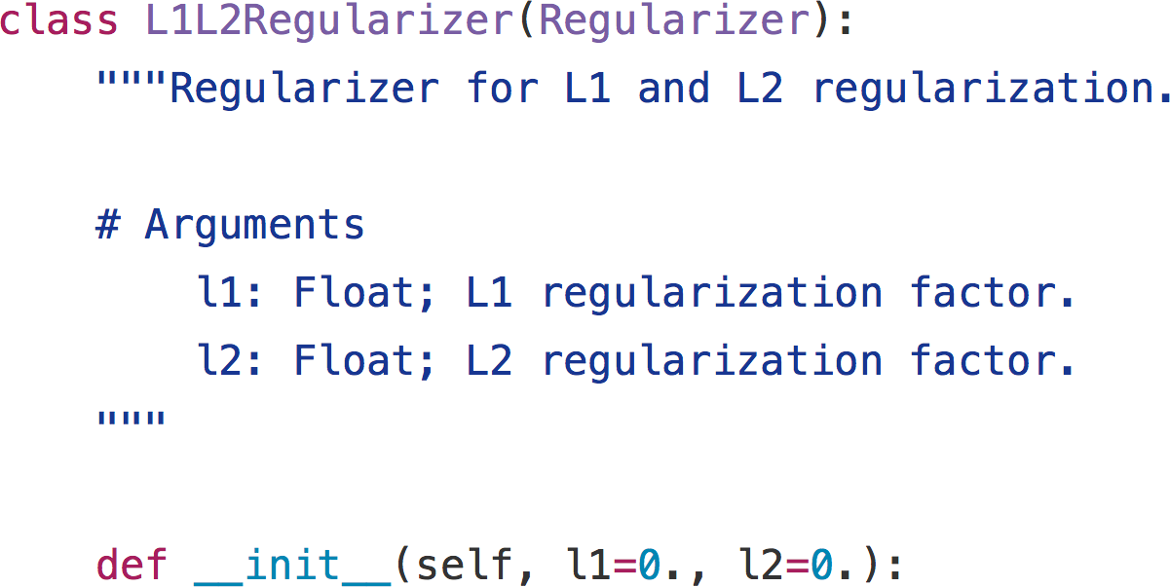
L1 weight penalty
•
•
L2 weight penalty

Slide 23
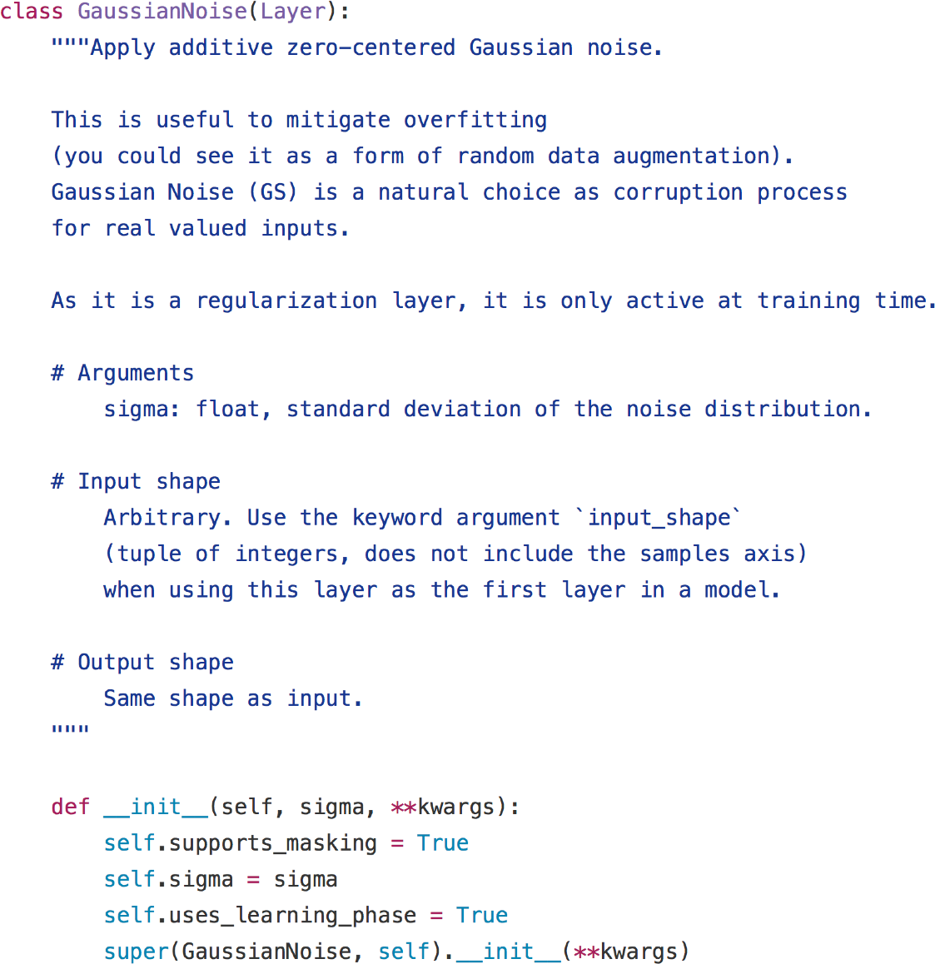

Slide 24
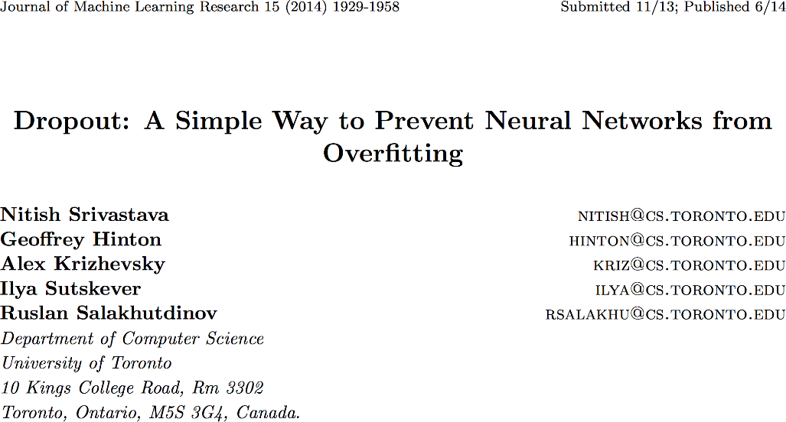
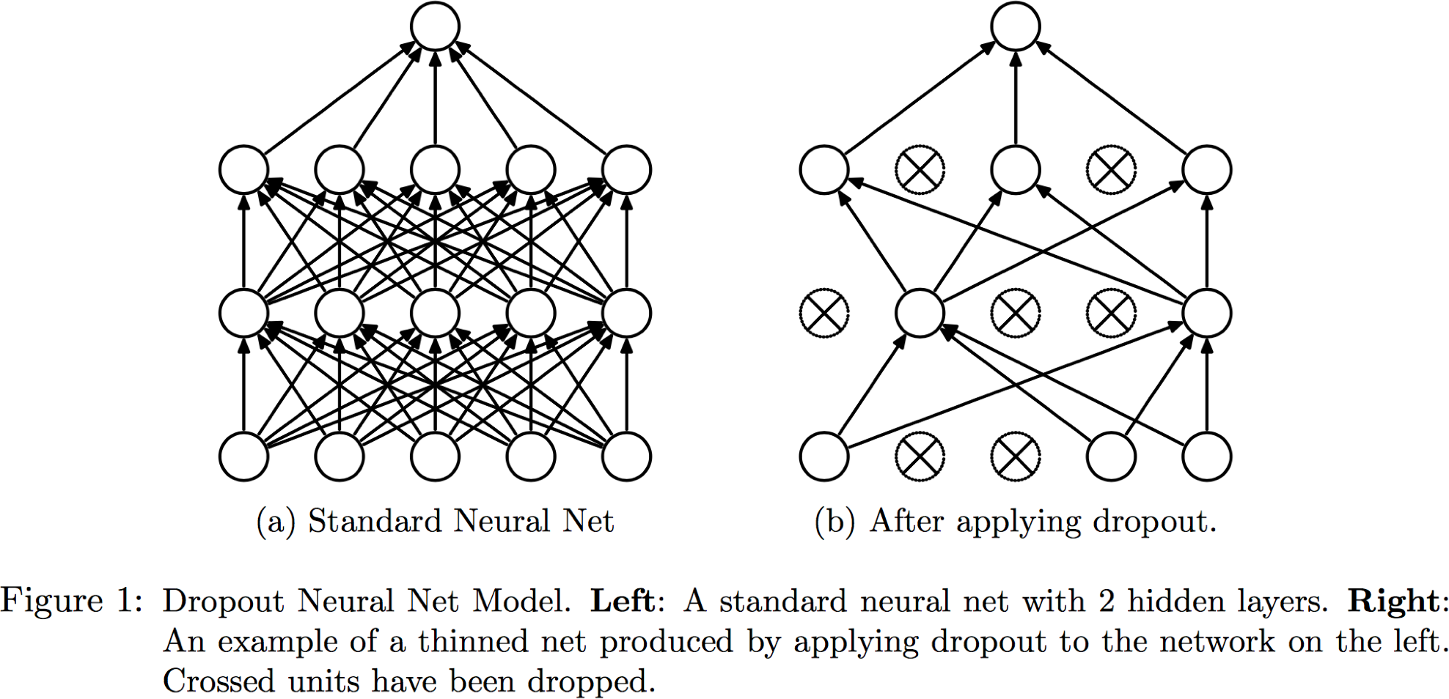

Slide 25
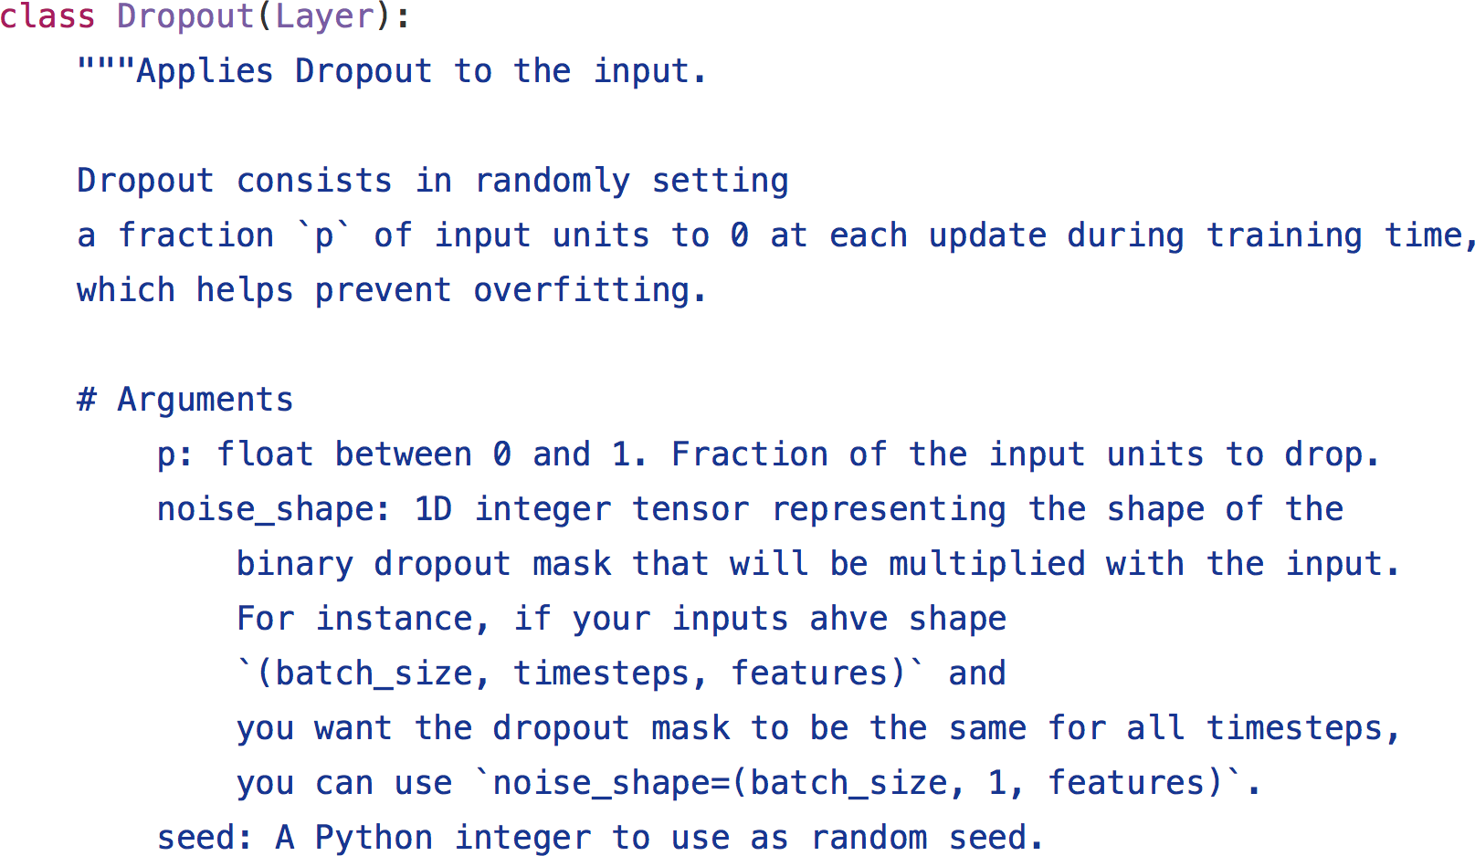

Slide 26
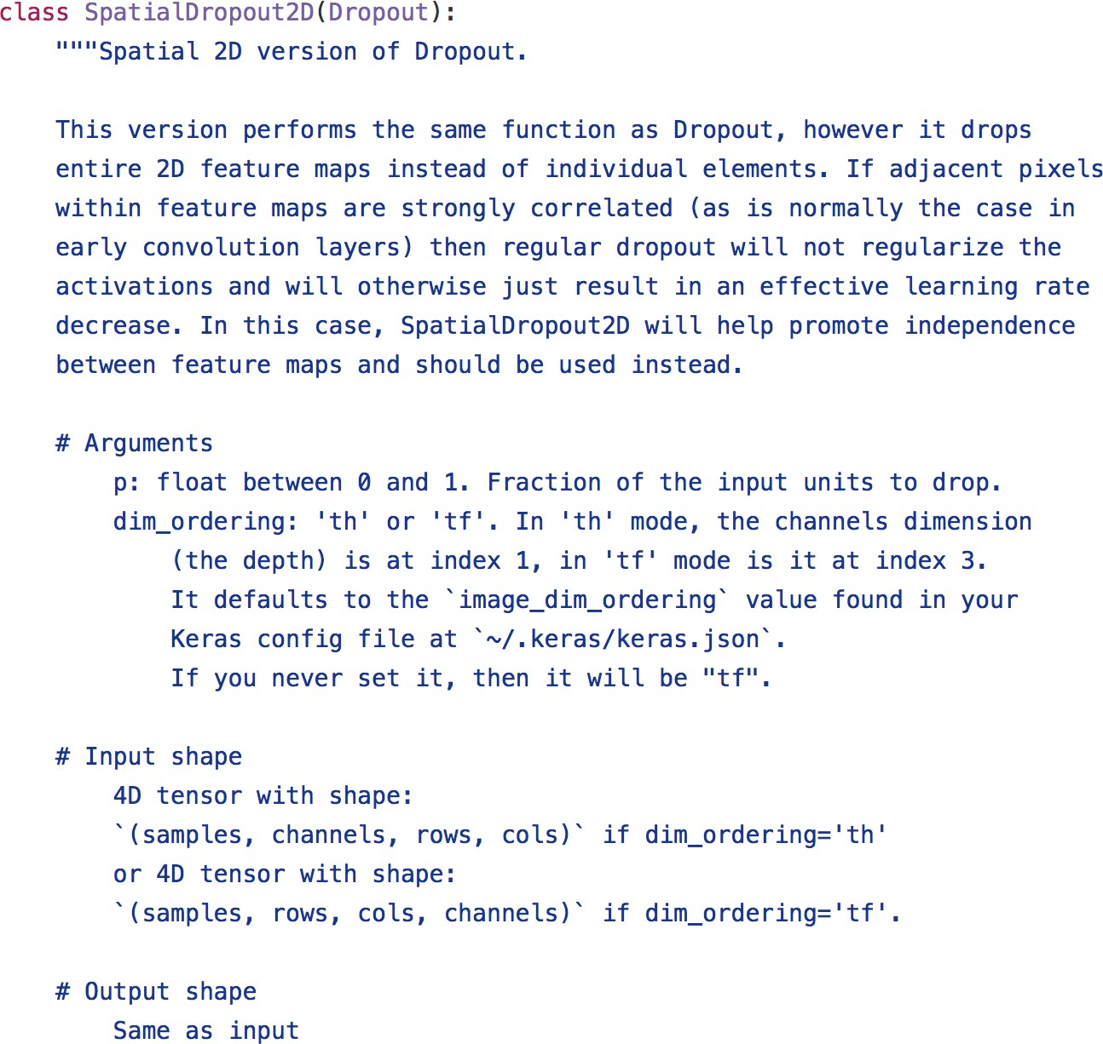

Slide 27
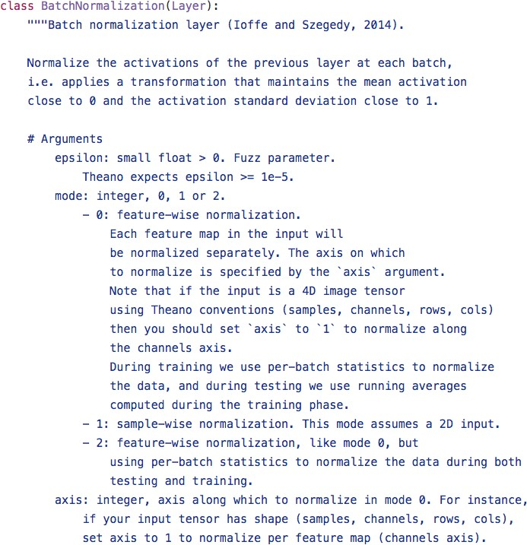

Slide 28
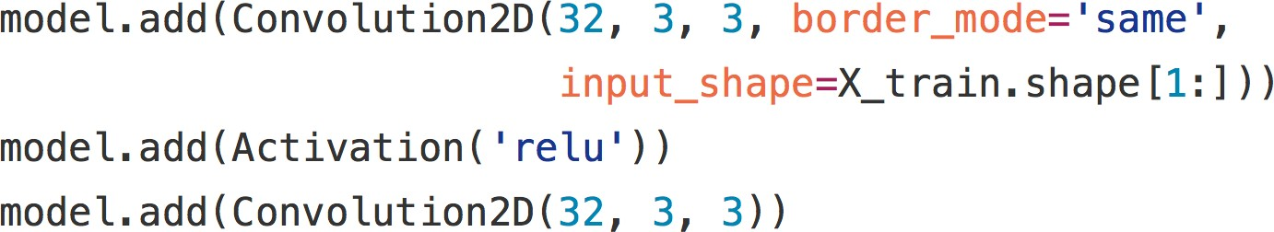

Slide 29
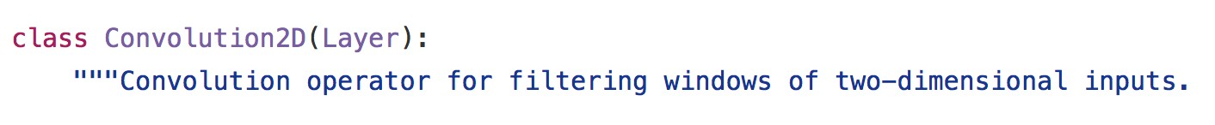
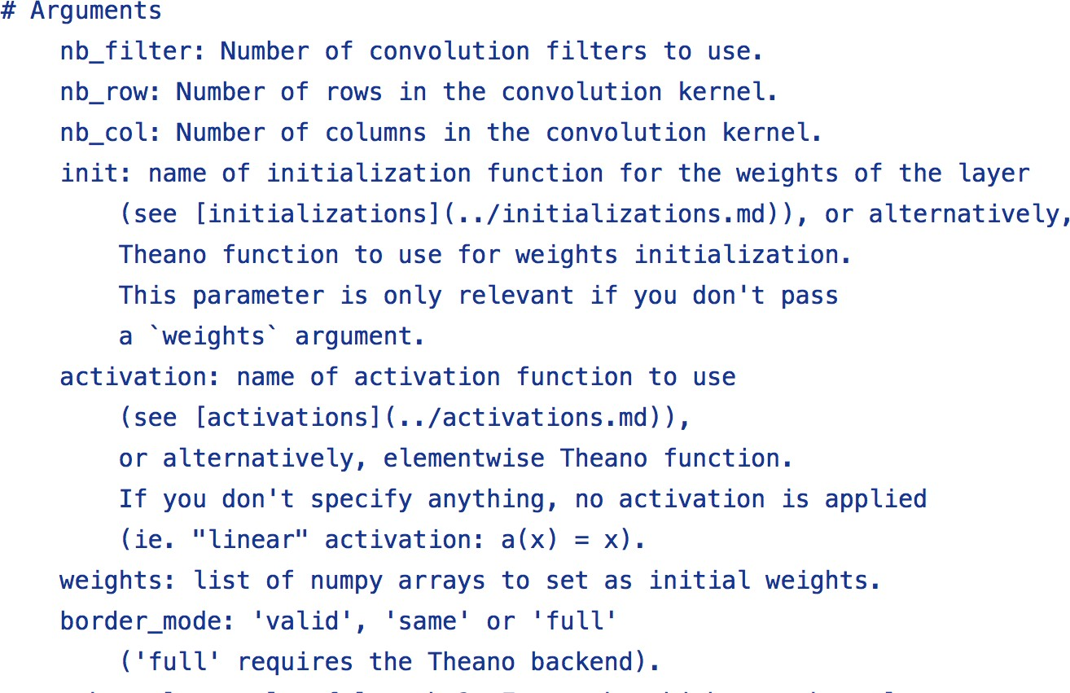

Slide 30
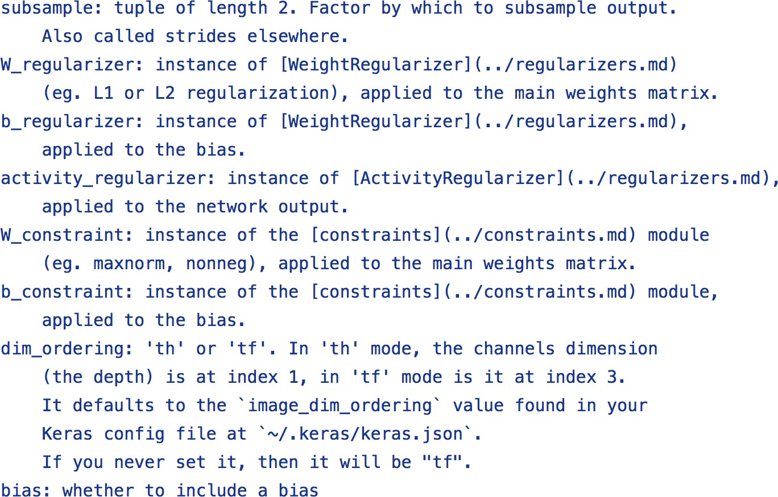

Slide 31
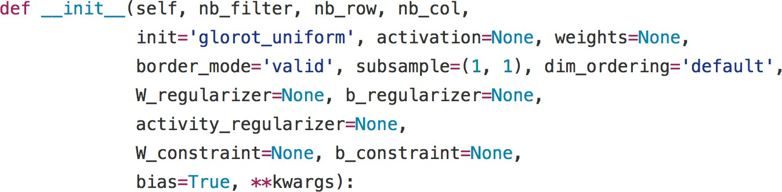

Slide 32
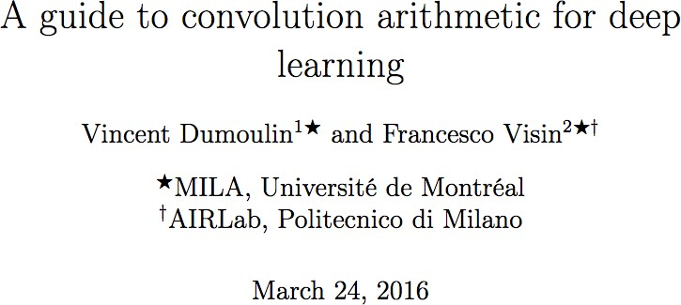
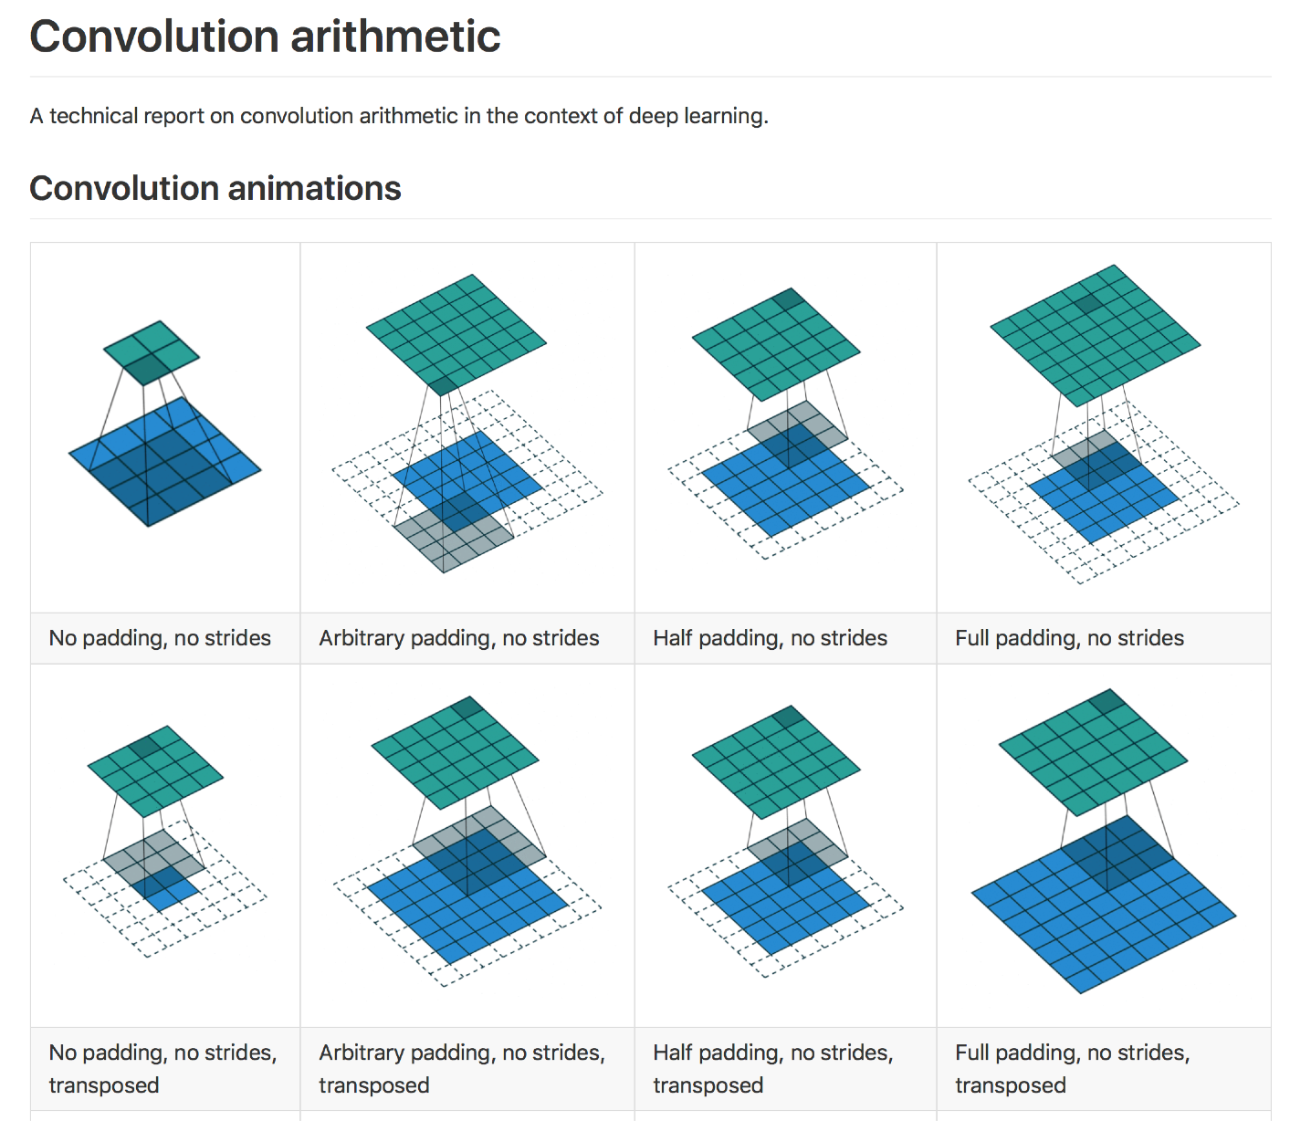
https://github.com/vdumoulin/conv_arithmetic

Slide 33
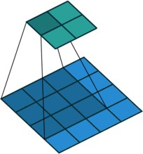
https://github.com/vdumoulin/conv_arithmetic
border_mode = ‘valid’
no strides: subsample= (1,1)

Slide 34

https://github.com/vdumoulin/conv_arithmetic
border_mode = ‘same’ no strides: subsample= (1,1)

Slide 35
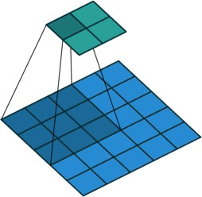
https://github.com/vdumoulin/conv_arithmetic
border_mode = ‘valid’ 2x2 strides: subsample= (2,2)

Slide 36
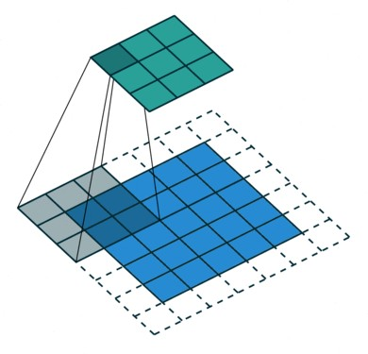
https://github.com/vdumoulin/conv_arithmetic
border_mode = ‘same’ 2x2 strides: subsample= (2,2)

Slide 37
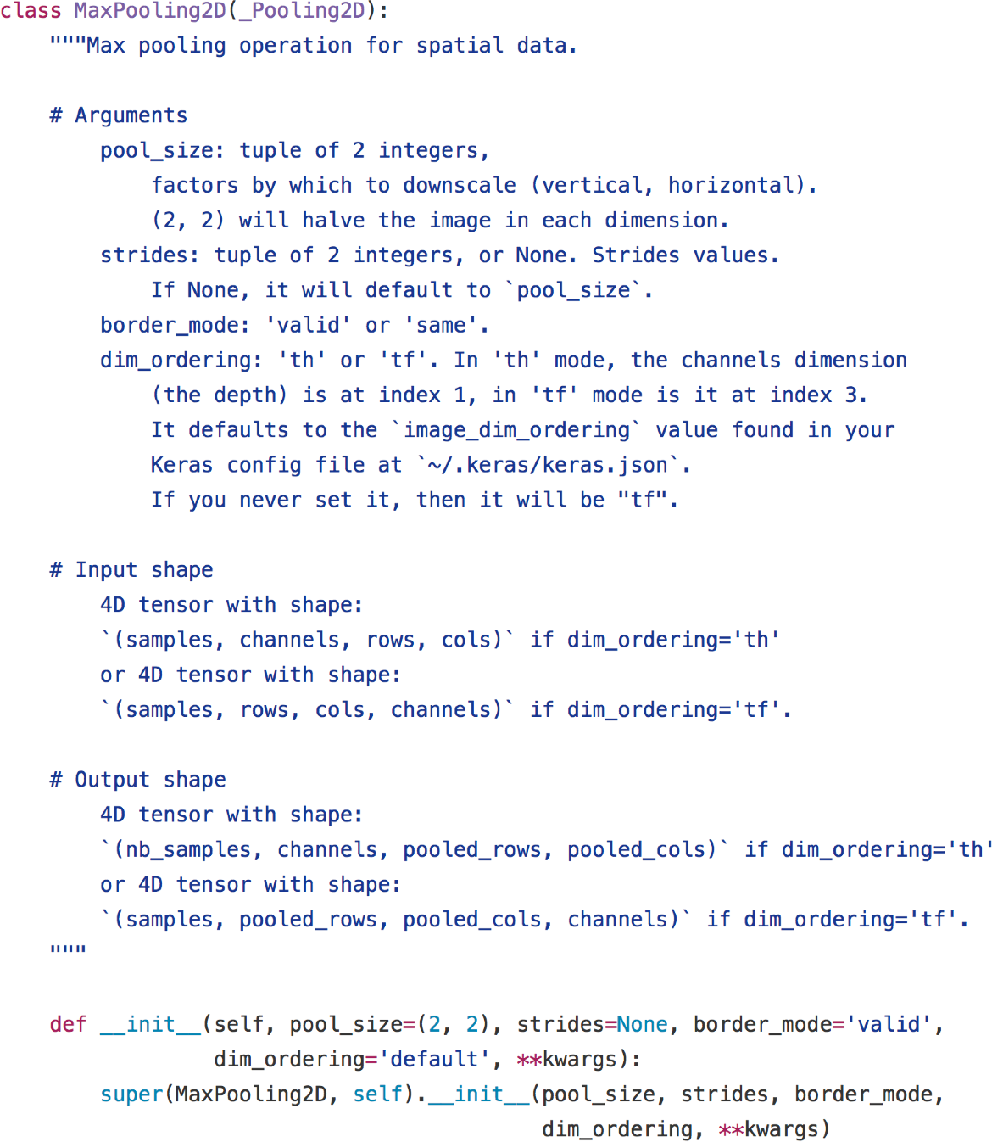

Slide 38
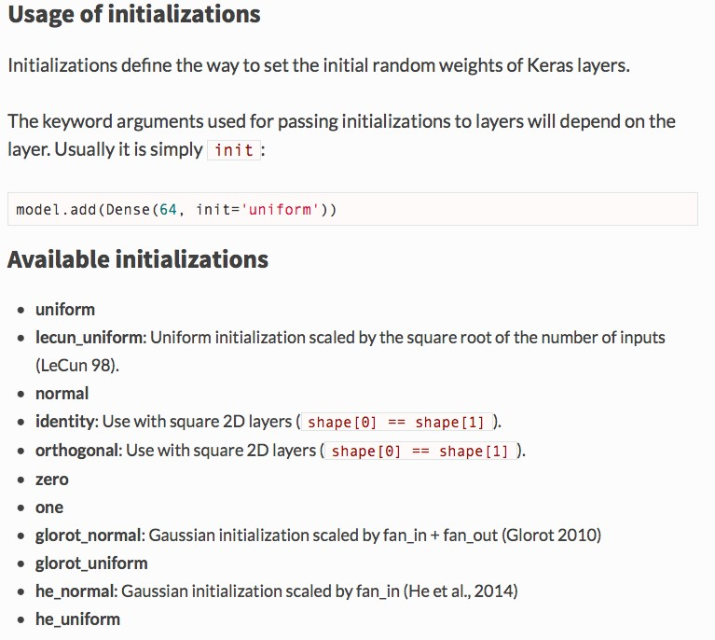
Initializations
For a discussion of weight initializations: http://cs231n.github.io/neural-networks-2/#init

Slide 39
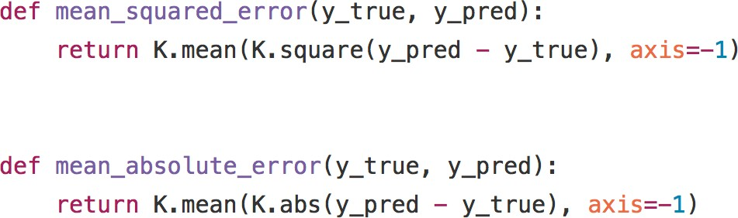

Slide 40
SGD
RMSProp Adam
Tune the learning rate!

Slide 41
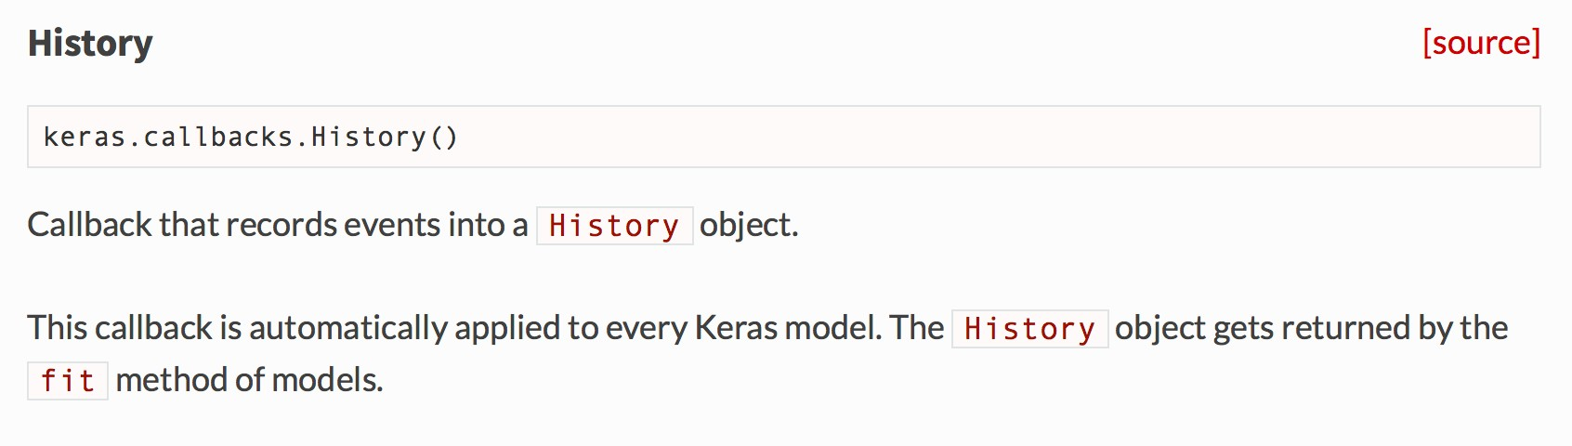
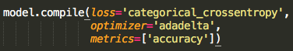
Use metrics to specify what you want in history
Up to you to save it!

Slide 42
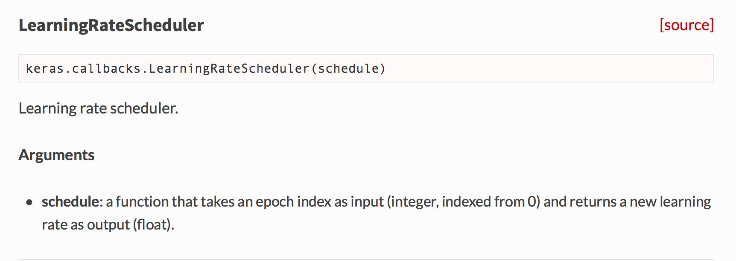

Slide 43
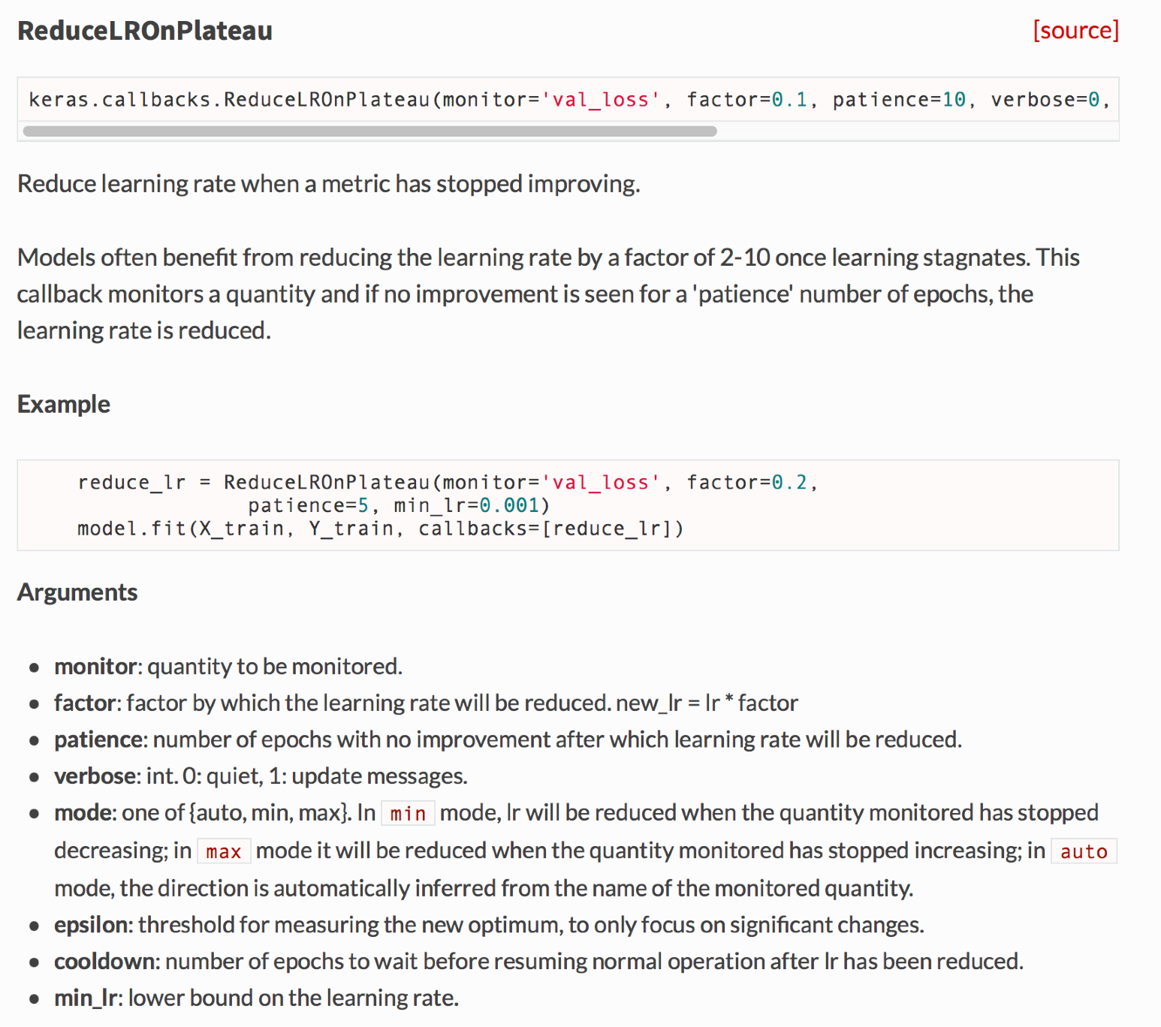

Slide 44
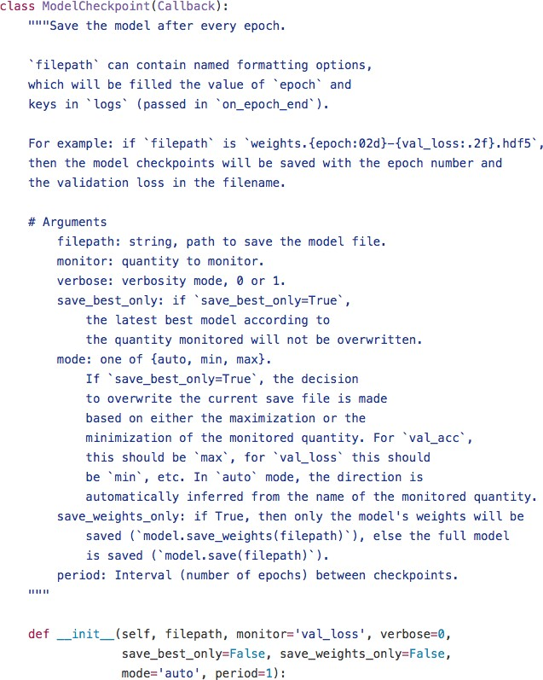

Slide 45
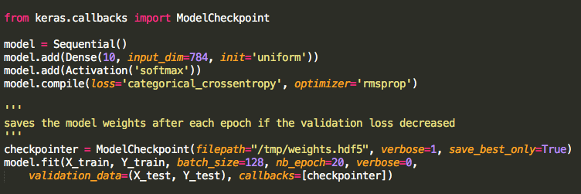

Slide 46
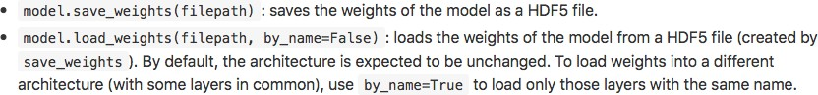
Saving and loading weights

Slide 47
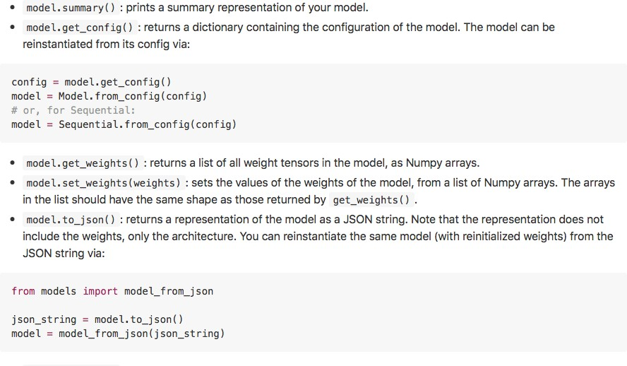
Saving and loading a model

Slide 48


Slide 49
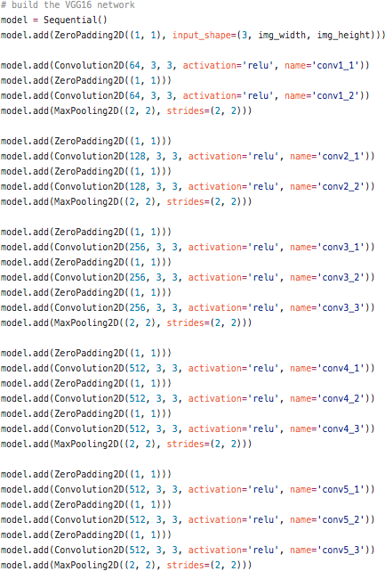
Loading a retrained model: first approach

Slide 50
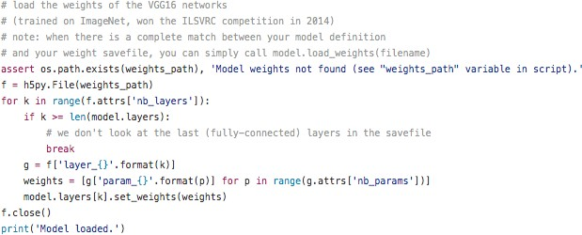
Loading a retrained model: first approach

Slide 51
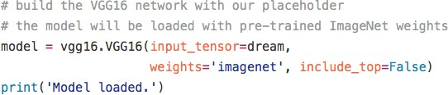
Loading a retrained model: second approach

Slide 52
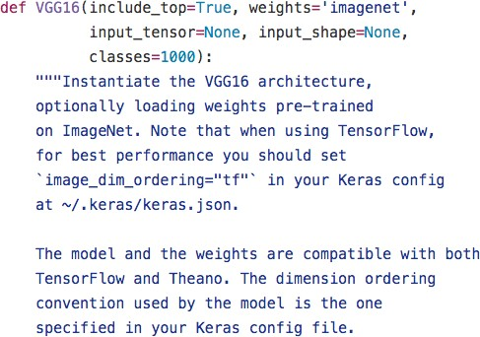
Loading a retrained model: second approach

Slide 53
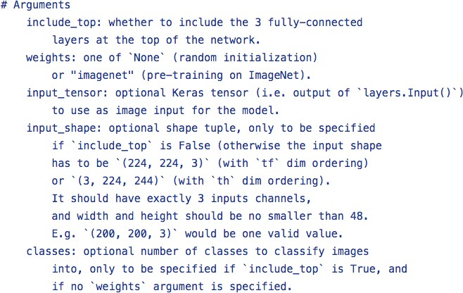
Loading a retrained model: second approach

Slide 54
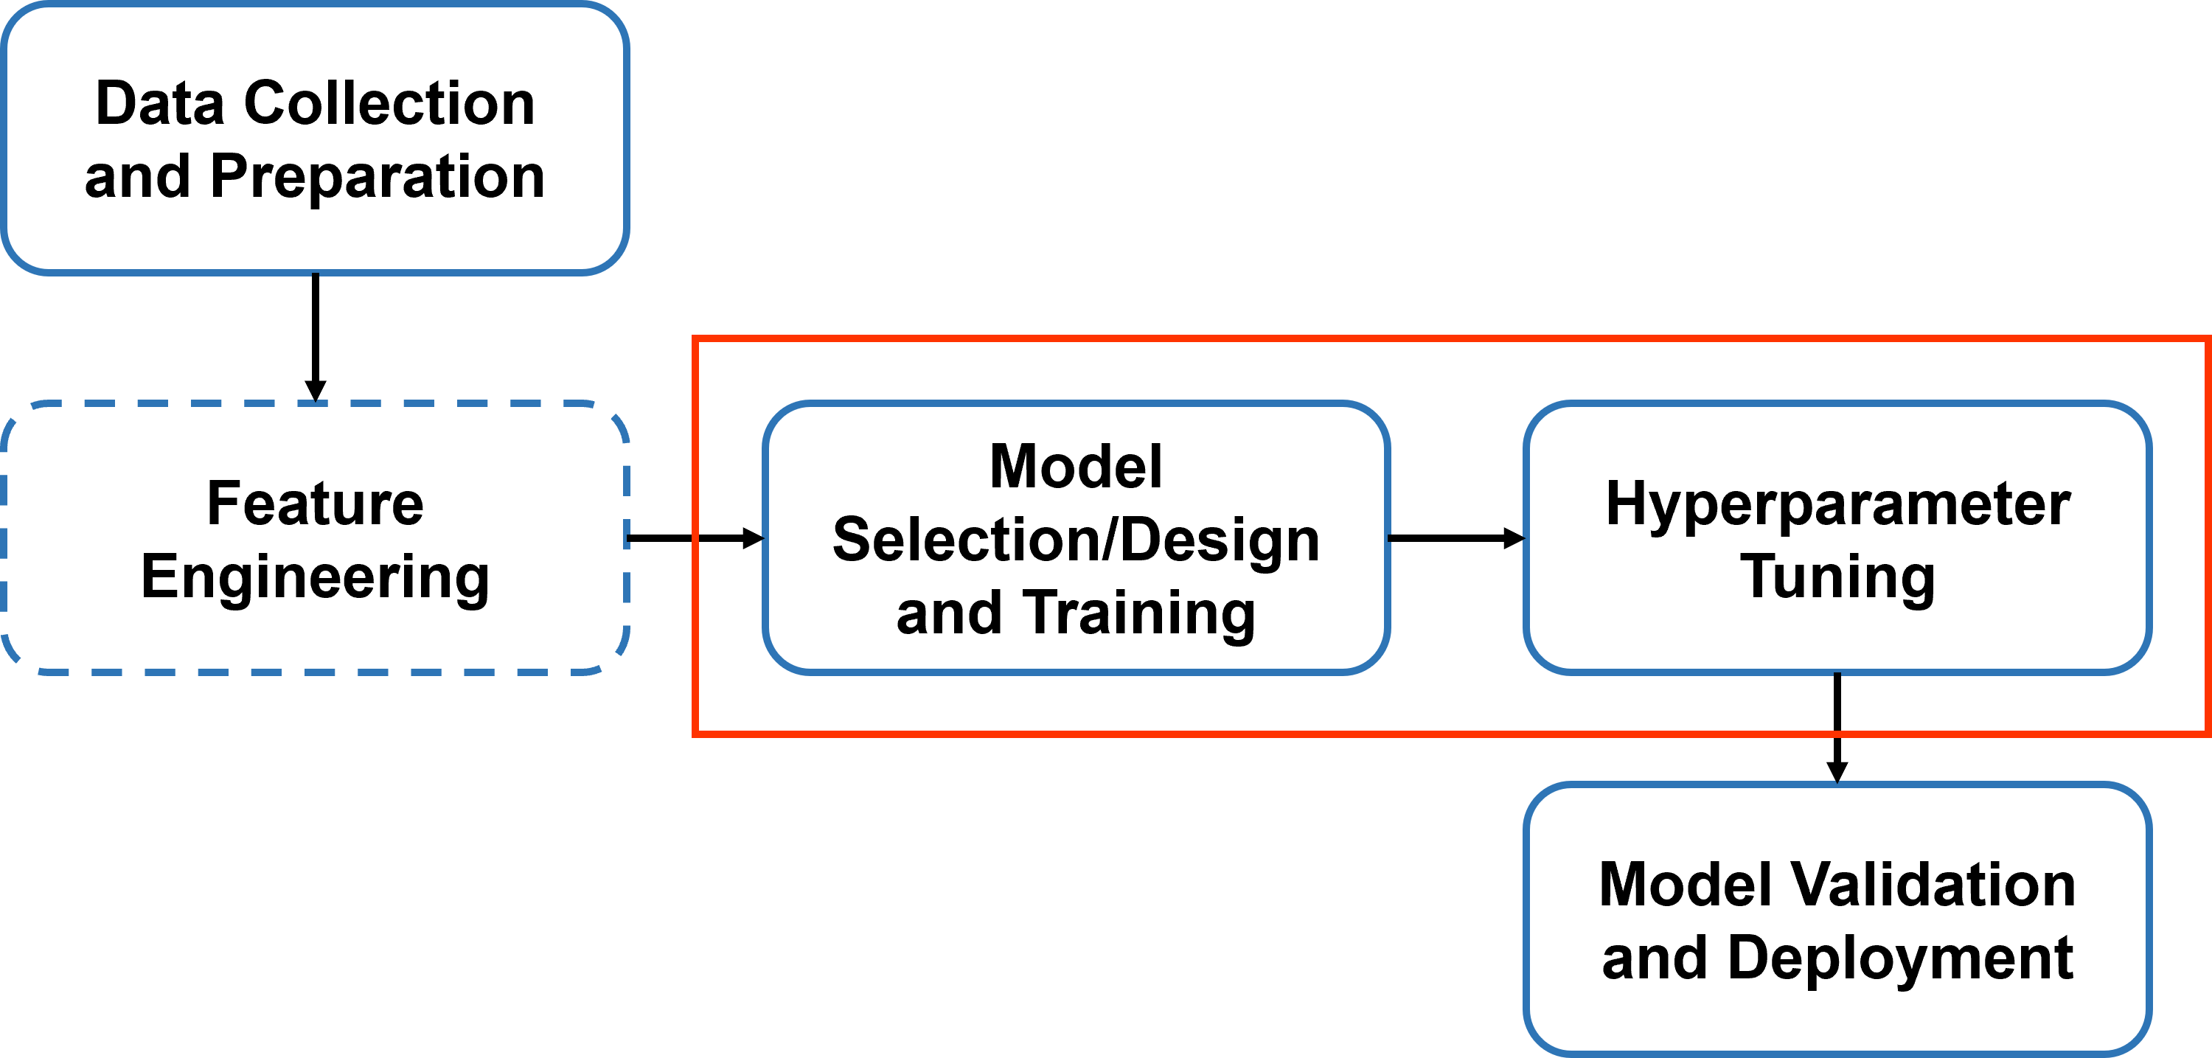
Challenges in Tuning Hyperparameters
Solving a problem with deep learning often follows a pipeline that includes feature engineering, model selection, training by tuning hyperparameters, and validation.
Hyperparameters (HPs) can be divided into two categories:
Training-related: learning rate, batch size, dropout rate, and epoch count
Model design-related: model structure, regularization, and activation functions
Due to the number of hyperparameters involved, it is nearly impossible to explore all possible combinations.
Autotuning is an active research area that involves automated search techniques to find an optimal solution.
A few popular autotuning algorithms are Grid Search, Random Search, Bayesian Optimization, and Gradient-based Optimization.
Keras Tuner uses random search for finding a generalized solution.

Slide 55
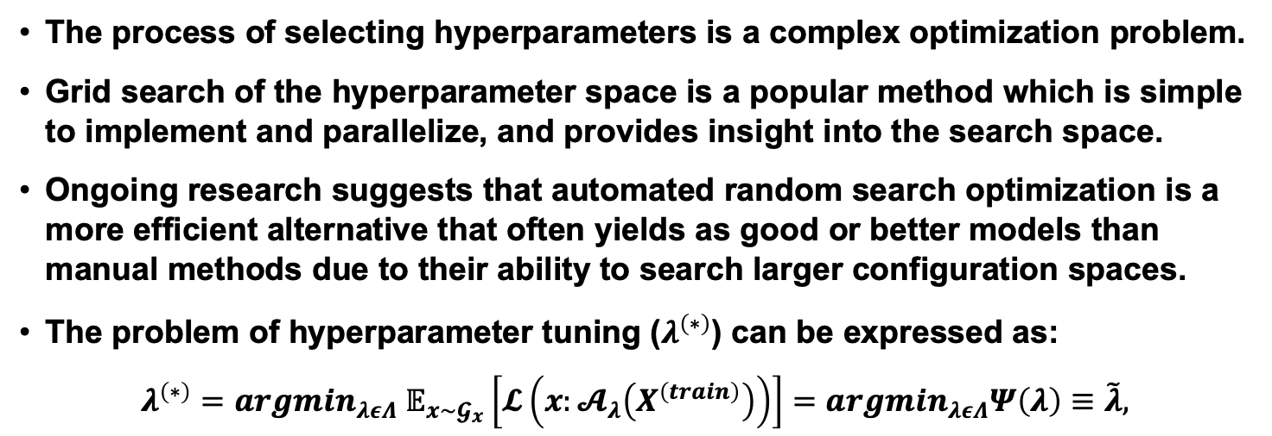
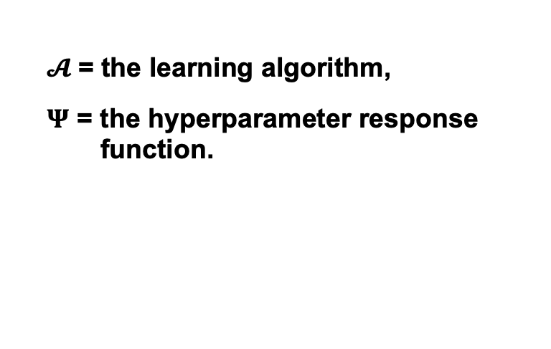
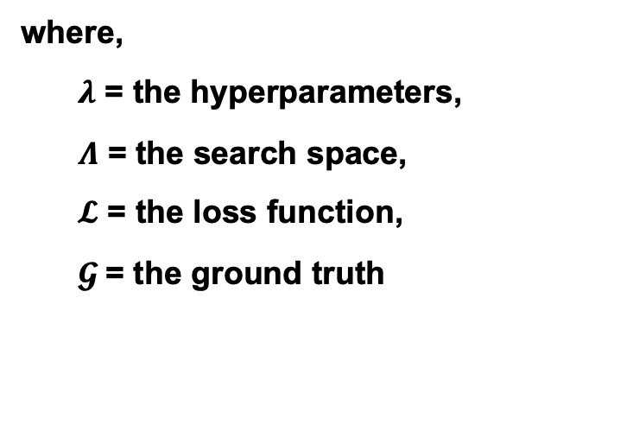
Hyperparameter Tuning
The process of selecting hyperparameters is a complex optimization problem.
Grid search of the hyperparameter space is a popular method which is simple to implement and parallelize, and provides insight into the search space.
Ongoing research suggests that automated random search optimization is a more efficient alternative that often yields as good or better models than manual methods due to their ability to search larger configuration spaces.
The problem of hyperparameter tuning ($λ^{\left(∗\right)}$) can be expressed as:
$$λ^{\left(∗\right)}=argmin_{λεΛ} 𝔼_{x\sim 𝓖_{x}}\left[\begin{matrix}𝓛\left(x:𝓐_{λ}\left(X^{\left(train\right)}\right)\right)\end{matrix}\right]=argmin_{λεΛ}Ψ\left(λ\right)≡\tilde{λ},$$
where,
$λ$ = the hyperparameters,
$Λ$ = the search space,
$𝓛$ = the loss function,
$𝓖$= the ground truth
$𝓐$= the learning algorithm,
$Ψ$ = the hyperparameter response function.

